Slide 1
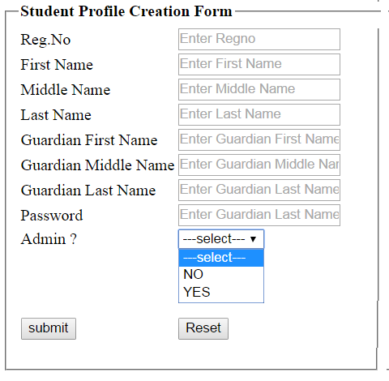
Servlet Practical Exercise 1
Create a html form as show bellow..
CreateProfile.html

Slide 2
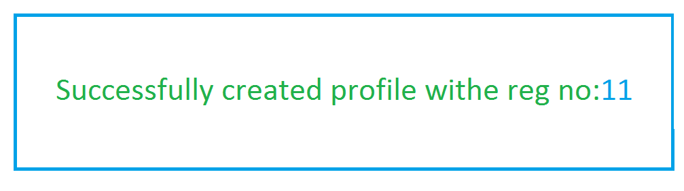
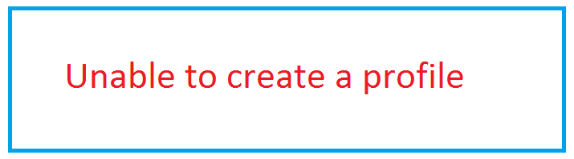
Create the Servlet which collects the all the above information from the form(createProfile.html) & stores it in to a DB and generates the success or error message accordingly.
Success message Error message

Slide 3
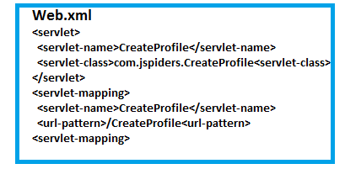
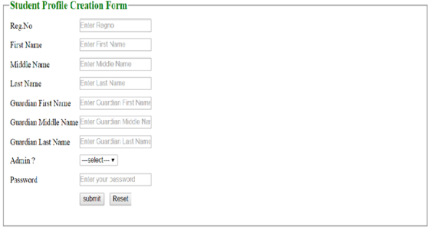
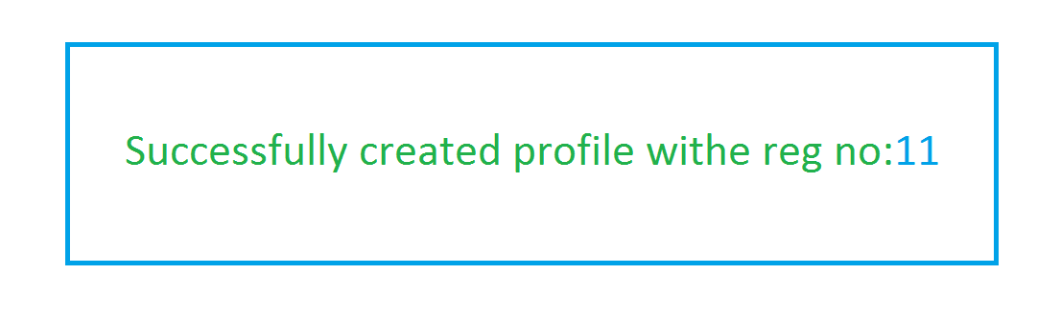
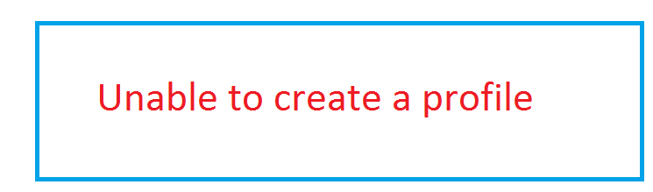
Make use of this url in html page
<form action=“http://localhost:8080/studentsApp/createProfile” method=“post”></form>
CreateProfileServlet
Extends HttpServlet
JDBC
Driver
DB
doPost(HSR,HSR)
Get the form data
Use JDBC to interact with database
BECM3_DB
Student_info
Guarduan_info
Students_otherinfo
1. Load the Driver
2. Get the DB Connection via Driver
3. Issue SQL Queries via Connection
call studentUpsert(?,?,?,?,?,?,?,?,?)
4. Process the Results
print the success or error message in the browser.
5. Close All JDBC Objects
Note: make use of this ulr to access the html page
http://localhost:8080/studentsApp/CreateProfile.html

Slide 4
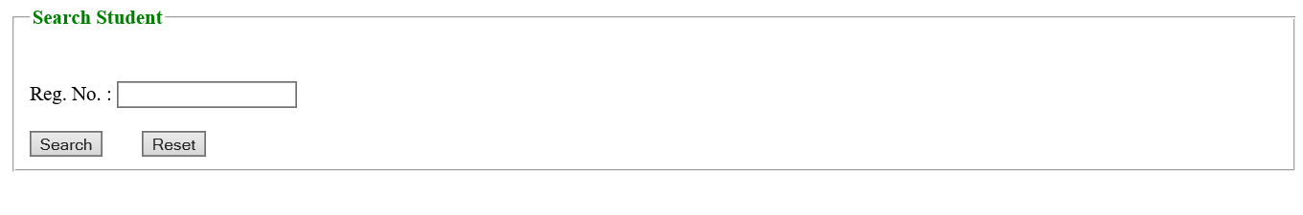
ASSIGNMENT 2
Create a html form as show bellow..
Search.html

Slide 5

Create a servlet which takes the regno from the user (search.html) .
Check the regno in all 3 tables which we have in the database.
If regno is present, fetch the data from the tables(combination of data present in students_info, guardian_info and students_otherinfo) and print on the browser.
If regno is not present, print the error message on the browser.
Success message Error message
Regno | firstname | midname | lastname | Gfirstname | Gmidname | Glastname | isadmin
1 | Praveen | N | D | D | N | A | Y

Slide 6


Make use of this url in html page
<form action=“http://localhost:8080/studentsApp/search” method=“post”></form>
Web.xml
<servlet><servlet-name>searchStudent</servlet-name>
<servlet-class>com.jspiders.SearchStudentServlet</servlet-class>
</servlet>
<servlet-mapping>
<servlet-name>SearchStudent</servlet-name>
<url-pattern>/search</url-pattern>
SearchStudentServlet
Extends HttpServlet
JDBC
JDBC
DB
doPost(HSR,HSR)
Get the form data
Use JDBC to interact with database
BECM3
1. Load the Driver
2. Get the DB Connection via Driver
3. Issue SQL Queries via Connection
Select * from students_info si,guardian_info gi, students_otherinfo soi
where si.regno=gi.regno and gi.regno=soi.regno and soi.regno=?
4. Process the Results
print the success or error message in the browser.
5. Close All JDBC Objects
Regno | firstname | midname | lastname | Gfirstname | Gmidname | Glastname | isadmin
1 | Praveen | N | D | D | N | A | Y

Slide 7
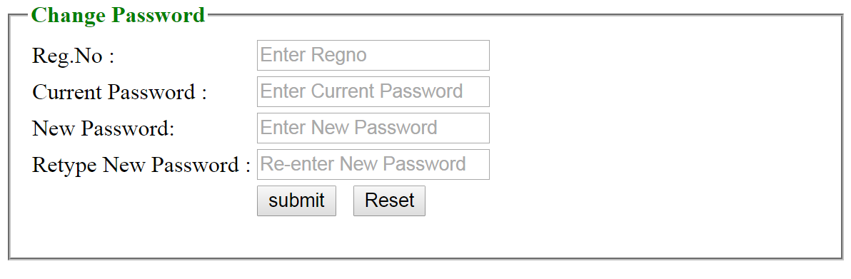
ASSIGNMENT 3
Create the html page as shown bellow..
changePassword.html
All data should be mandatory.
New password and Retype New password should match.

Slide 8
Create a servlet which takes the regno, old password, new password, retype New password from the user(changePassword.html).
This program should check new password and retype new password is matching or what.
If not matching print “new password & retype new password is not matching” on the browser.
If matching then should check whether the RegNo and password is correct in the database.
if Yes, then update the current password with new password,
if No then print the error message in the browser.

Slide 9
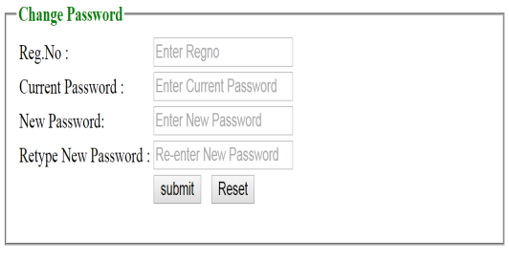
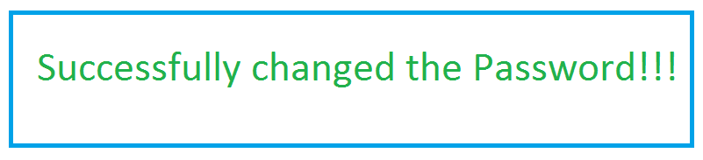
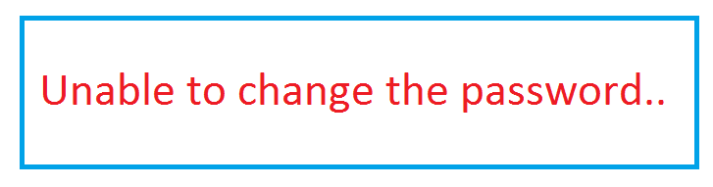
Make use of this url in html page
<form action=“http://localhost:8080/studentsApp/changePassword” method=“post”></form>
Web.xml
<servlet><servlet-name>ChangePassword</servlet-name>
<servlet-class>com.jspiders.ChangePasswordt</servlet-class>
</servlet>
<servlet-mapping>
<servlet-name>ChangePassword</servlet-name>
<url-pattern>/changePassword</url-pattern>
BECM3_DB
ChangePasswordServlet
Extends HttpServlet
JDBC
Driver
DB
doPost(HSR,HSR)
Get the form data
Use JDBC to interact with database
1. Load the Driver
2. Get the DB Connection via Driver
3. Issue SQL Queries via Connection
Update students_otherinfo set password=? Where regno=? And password=?
4. Process the Results
print the success or error message in the browser.
5. Close All JDBC Objects
Note: Make use of this url to access html page
http://localhost:8080/studentsApp/changePassword.html

Slide 10
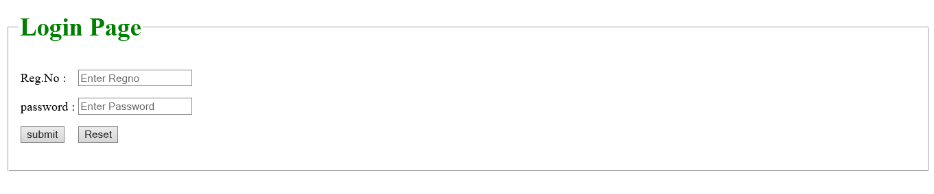
ASSIGNMENT 4
Create html page as show bellow..
Login.html
All data should be mandatory.

Slide 11
Create a servlet which takes regno and password from the user (login.html).
The program should check regno & password are correct.
If Yes then check whether that user in admin user or normal user
i) If admin user print as shown bellow.
ii) If normal user print his details
3. If No print the error message on the browser.

Slide 12
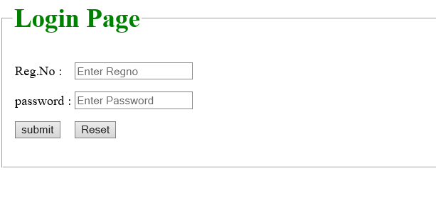
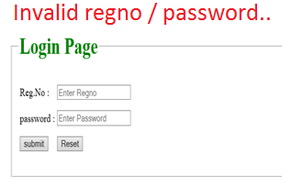
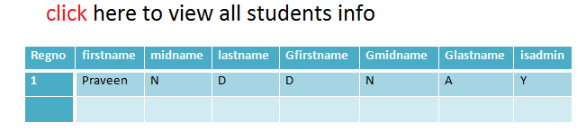
Make use of this url in html page
<form action=“http://localhost:8080/studentsApp/login” method=“post”></form>
Web.xml
<servlet><servlet-name>LoginServlet</servlet-name>
<servlet-class>com.jspiders. LoginServlet</servlet-class>
</servlet>
<servlet-mapping>
<servlet-name>LoginServlet</servlet-name>
<url-pattern>/login</url-pattern>
BECM3_Db
LoginServlet
Extends HttpServlet
JDBC
Driver
DB
doPost(HSR,HSR)
Get the form data
Use JDBC to interact with database
1. Load the Driver
2. Get the DB Connection via Driver
3. Issue SQL Queries via Connection
Select * from students_info si,guardian_info gi,students_otherinfo soi where si.regno=gi.regno and gi.regno=soi.regno and soi.regno=? and soi.password=?
4. Process the Results
print the success or error message in the browser.
5. Close All JDBC Objects

Slide 13
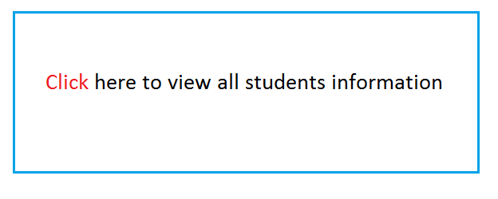
ASSIGNMENT 5
Create html page as shown bellow..
viewAllStudents.html

Slide 14
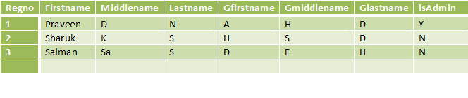
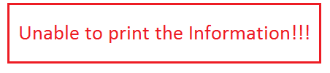
Create a servlet for the above html page and print all the students information on the browser or print error message on the browser as shown bellow.
Success message Error message

Slide 15
Make use of this url in html page
<p><a href=“http://localhost:8080/studentsApp/view” >Click</a>here to view all students </p>
Web.xml
<servlet><servlet-name>ViewAllStudents</servlet-name>
<servlet-class>com.jspiders. ViewAllStudents</servlet-class>
</servlet>
<servlet-mapping>
<servlet-name>ViewAllStudents</servlet-name>
<url-pattern>/view</url-pattern>
BECM3_DB
ViewAllStudents
Extends HttpServlet
JDBC
Driver
DB
doPost(HSR,HSR)
Get the form data
Use JDBC to interact with database
1. Load the Driver
2. Get the DB Connection via Driver
3. Issue SQL Queries via Connection
Select * from students_info si,guardian_info gi,students_otherinfo soi where si.regno=gi.regno and gi.regno=soi.regno
4. Process the Results
print the success or error message in the browser.
5. Close All JDBC Objects
Note: Make use of this url to access html page
http://localhost:8080/studentsApp/ViewAllStudents.html

Slide 16
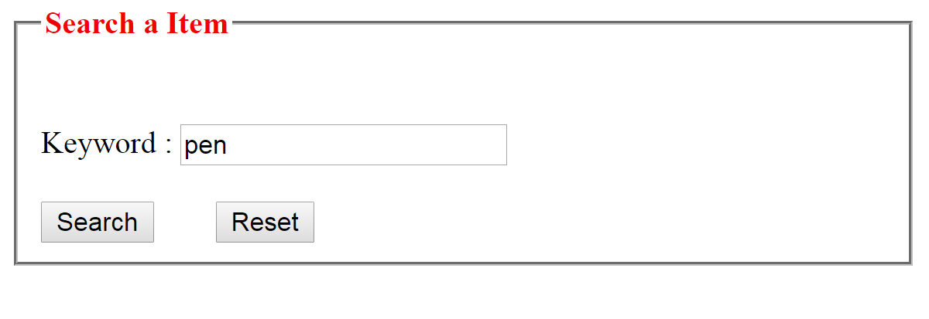
ASSIGNMENT 6
Create the html page as show bellow..
graingerSearch.html
Data should be mandatory

Slide 17
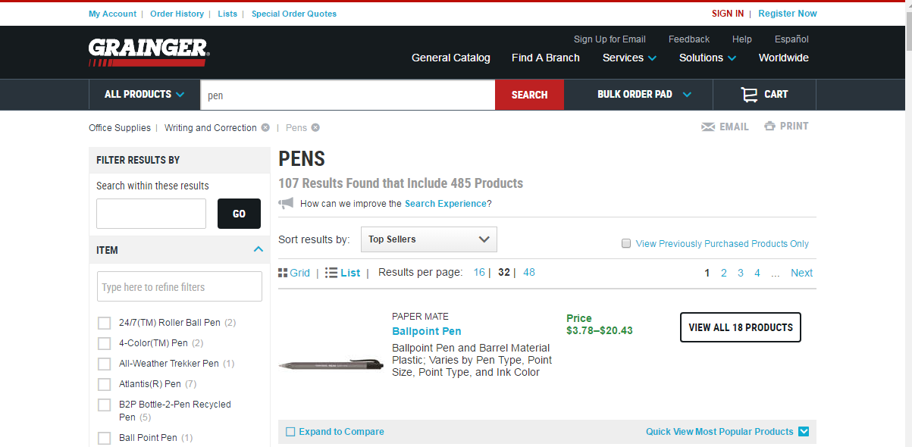
Create a servlet that takes input from the user (graingerSearch.html).
This program should take the input keyword from the user and that keyword is print on the www.grainger.com web application search engine like bellow.

Slide 18
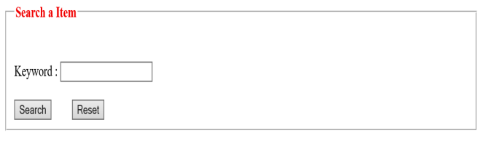
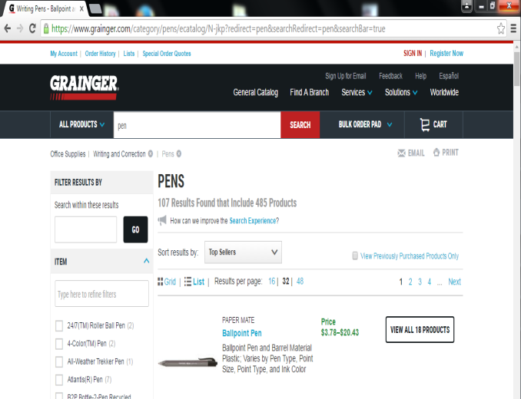
Make use of this url in html page
<form action=“http://localhost:8080/studentsApp/grangerSearvh” method=“post”></form>
Web.xml
<servlet><servlet-name>GraingerSearch</servlet-name>
<servlet-class>com.jspiders. GraingerSearch</servlet-class>
</servlet>
<servlet-mapping>
<servlet-name>GraingerSearch</servlet-name>
<url-pattern>/graingerSearch</url-pattern>
GraingerSearch
Extends HttpServlet
WWW.grainger.com
doPost(HSR,HSR)
Get the form data from the html
String keywordVal=reg.getParamenter(“keyword”);
String url=“http://www.grainger.com/search?searchQuery=“
response.sendRedirect(url+keywordval);
Note: Make use of this url to access html page
http://localhost:8080/studentsApp/graingerSearch.html

